Slide 1
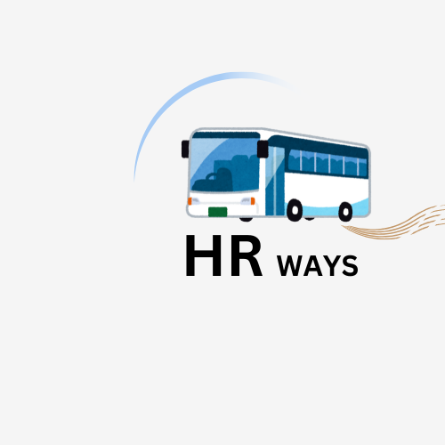
Welcome
To
HRWAYS
Made by Script Surfers

Slide 2
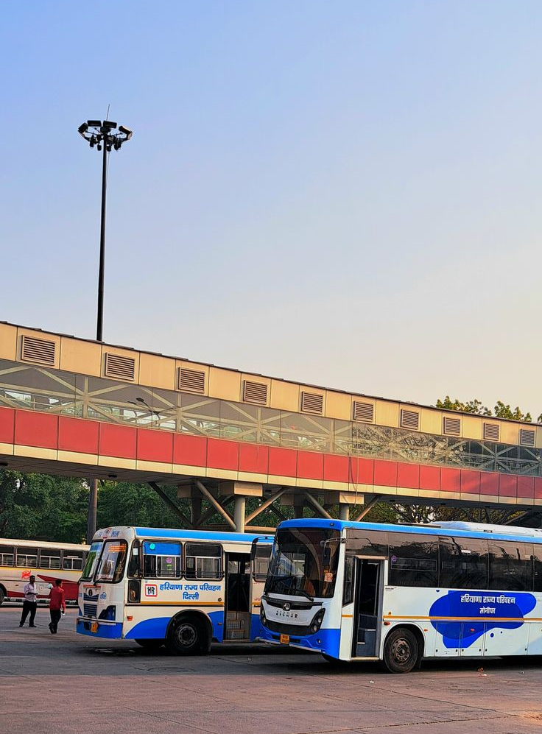
Haryana Roadways Bus Tracker: Real-Time Location and More
Commuters in Haryana face challenges with unpredictable public transportation. This new mobile app aims to provide real-time visibility into bus locations, routes, schedules and alerts - empowering users to plan their journeys with confidence.

Slide 3

Introduction to the Problem: Lack of Transparency in Public Transportation
1
Unpredictable Arrivals
2
Unclear Routes
Commuters often have no way to know when their bus will arrive, leading to frustration and wasted time.
Navigating the bus system is difficult without easy access to route maps and schedule information.
3
Lack of Alerts
Commuters have no way to proactively plan for delays or service changes, leading to missed connections.

Slide 4
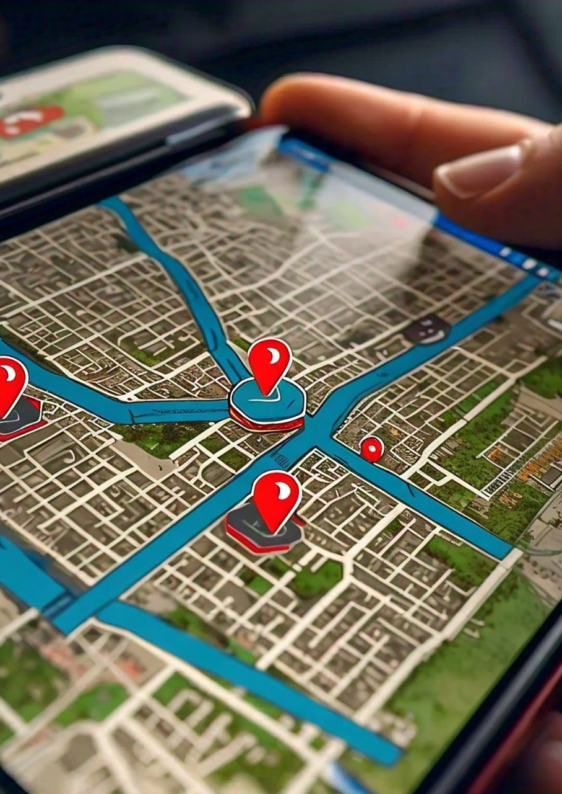
Key Features: Real-Time Bus Tracking, Route Information, Schedules, and Alerts
1
Live Bus Locations
Commuters can see the real-time position of buses on a map, allowing them to time their arrivals.
2
Route Details
Comprehensive route information, including pickup/drop-off points and estimated travel times.
3
Schedules & Alerts
Access to bus schedules and proactive notifications about delays, detours or service changes.

Slide 5




Technology Stack: Leveraging GPS, APIs, and Mobile Development Frameworks
GPS Tracking
Real-time bus locations are captured using GPS technology.
API Integration
The app connects to Haryana Roadways' APIs to fetch route, schedule and service data.
Mobile Frameworks
The app is built using popular cross-platform frameworks like React Native or Flutter.

Slide 6
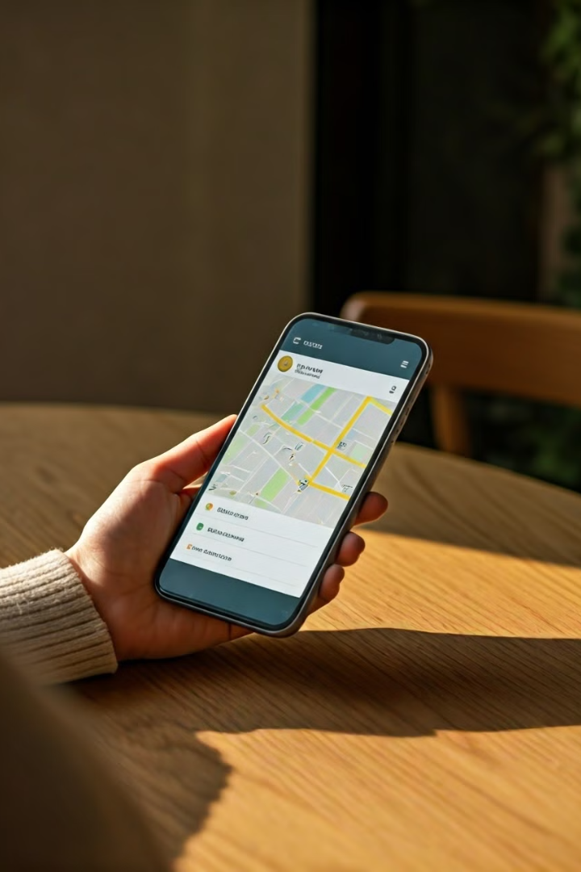
User Experience Design: Intuitive Interface and Responsive Design
Clean Interface
Responsive Layout
The app features a minimal, uncluttered design to ensure easy navigation and information access.
The app automatically adapts to different screen sizes and devices, providing a seamless experience.
Intuitive Navigation
Clear menus, intuitive icons, and smart defaults help users quickly find the information they need.

Slide 7
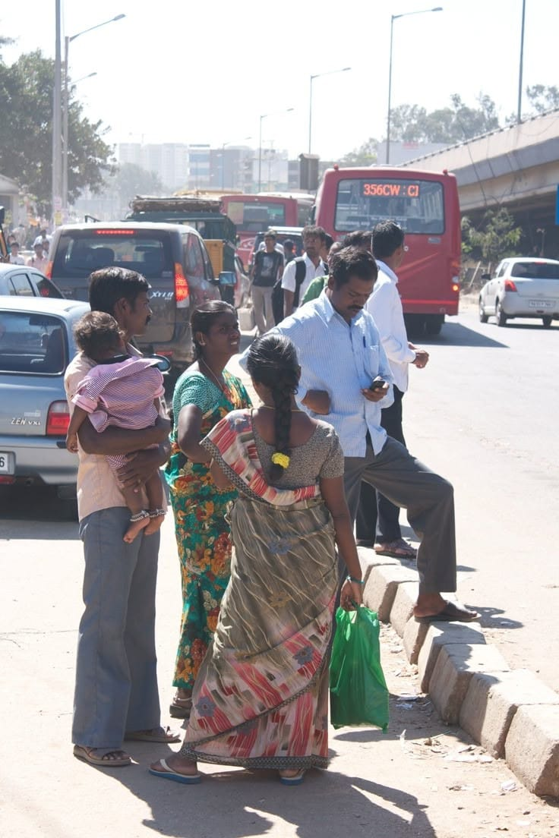



Potential Impact: Enhancing Commuter Experience and Improving Operational Efficiency
Reduced Waiting Times
Commuters can better time their arrivals, minimizing time spent waiting at bus stops.
Improved Connections
Real-time alerts help commuters adjust plans and make their connections on time.
Enhanced Operational Insights
The app's data can help Haryana Roadways optimize routes, schedules and resource allocation.

Slide 8
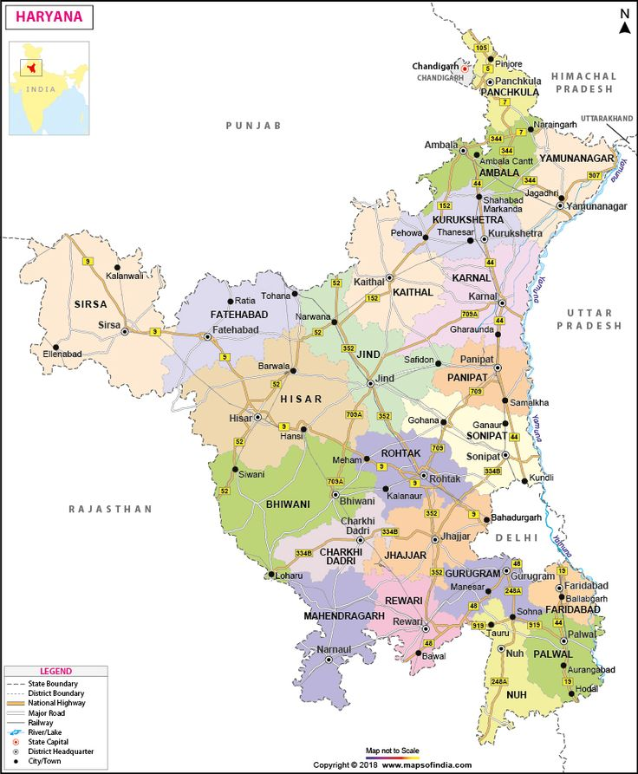
Conclusion: Roadmap for Implementation and Future Enhancements
1
Pilot Program
Deploy the app in a select region to gather user feedback and refine the solution
2
Phased Rollout
Gradually expand the app’s coverage to the entire Haryana roadways network
3
Continuous Improvement
Regularly update the app with new features and integration based on user needs
By delivering real time visibility and enhanced services, this Haryana roadways mobile app has the potential to transform the daily commute for millions of passengers, while also driving operational efficiencies for the transportation authority
Made by script surfers

Slide 9
Thank You

